Slide 1


Slide 2

OVERVIEW
Big Data Issues
What is Alluxio
History and versions
Components
Architecture
Features
Security
Benefits
Alluxio Today
Installation
Mini project

Slide 3
Well if you take a quick look at the big data world today things can be split into 2 categories
a framework is often a layered structure indicating what kind of programs can or should be built and how they would interrelate.
The compute engine: Spark, Hadoop, Flink, … These are the big data frameworks that allows to run some computation over the data.
The physical storage: All this data must be stored somewhere most likely using some distributed file systems: HDFS, S3, GlusterFS, Parquet, …
And each compute engine should be able to access any of these file systems.

Slide 4
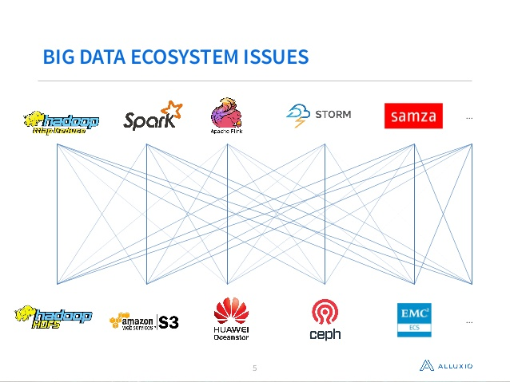

Slide 5



Slide 6


Alluxio is open source memory speed virtual distributed storage
open source:
Alluxio is open sourced under the Apache license 2.0.
It is free and its source code is available which can be modified and redistributed according to our needs
memory speed:
Like Spark, Alluxio leverages the fact that memory IO is much faster than disk IO and improves data access time which is quite important in a big data environment.
It stores data in RAM rather than accessing it from disk so it saves time and is much faster.

Slide 7
virtual:
Alluxio provides a virtual naming making it easy to access any data wherever it might be stored.
Much like we can easily access any file from a file system without knowing on which disk (or host) it resides – all we need to know is the path to that file.
Virtual hosting is a method for hosting multiple domain names (with separate handling of each name) on a single server (or pool of servers). This allows one server to share its resources, such as memory and processor cycles, without requiring all services provided to use the same host name.
Distributed storage:
Alluxio is distributed meaning it scales horizontally and run on commodity hardware.
horizontal scaling means that new systems can be introduced into the cluster.

Slide 8

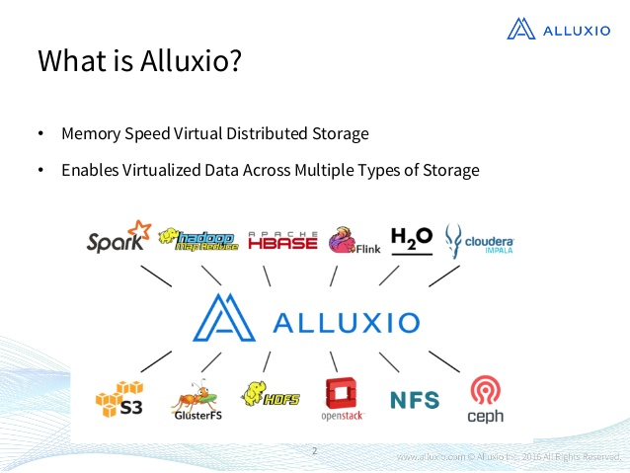
And this is exactly where Alluxio comes into place,
right in the middle, between these 2 categories.

Slide 9

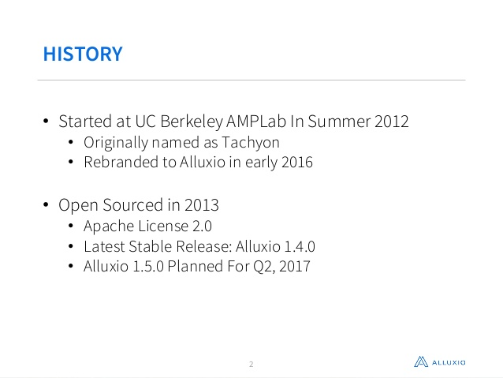
Alluxio 1.5.0
Release Date: Jun 12th, 2017
Alluxio 1.4.0
Release Date: Jan 13th, 2017
Alluxio 1.3.0
Release Date: Oct 7th, 2016
Alluxio 1.2.0
Release Date: Jul 19th, 2016
Alluxio 1.1.1
Release Date: Jul 7th, 2016
Alluxio 1.1.0
Release Date: Jun 7th, 2016
Alluxio 1.0.1
Release Date: Mar 28th, 2016
Alluxio 1.0.0
Release Date: Feb 23rd, 2016
Tachyon 0.8.2
Release Date: Feb 23rd, 2016
history
Haoyuan Li
Started at UC Berkeley AMPLab in
Summer 2012
Originally named as Tachyon
Rebranded to Alluxio in early 2016

Slide 10
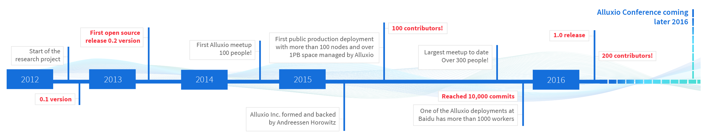
Progress of alluxio

Slide 11

COMPONENTS

Slide 12

Metadata is data that describes other data. Meta is a prefix that in most information technology usages means "an underlying definition or description."
Metadata summarizes basic information about data, which can make finding and working with particular instances of data easier
Alluxio’s design uses a single primary master and multiple workers. At a very high level, Alluxio can be divided into three components, the master, workers, and clients. The master and workers together make up the Alluxio servers, which are the components a system admin would maintain and manage.
The clients are generally the applications, such as Spark or MapReduce jobs, or Alluxio command-line users. Users of Alluxio will usually only need to interact with the client portion of Alluxio.
Master
Alluxio master can be deployed as primary master or secondary master.
Primary Master
The primary master is primarily responsible for managing the global metadata of the system, for example, the file system tree.
Clients may interact with the primary master to read or modify this metadata.
In addition, all workers periodically heartbeat to the primary master to maintain their participation in the cluster.
The primary master does not initiate communication with other components; it only interacts with other components by responding to requests.
There is one and only one primary master in an Alluxio cluster.

Slide 13
Secondary Master
The secondary master replays journals written by the primary master and periodically writes checkpoints.
It does not process any requests from any Alluxio components.
Master Deployment
Alluxio may be deployed in one of two master modes, simple mode or high availablity mode.
There must be one and only one primary master in both of the simple mode and the high availability mode.
The simple mode can at most have one secondary master which cannot be promoted to the primary master.
The high availability mode can have zero or more secondary masters, one of which will be promoted to the primary master if the primary master fails.
DEPLOYMENT-- the action of bringing resources into effective action.

Slide 14
Worker
Alluxio workers are responsible for managing local resources allocated to Alluxio. These resources could be local memory, SSD, or hard disk and are user configurable.
Alluxio workers store data as blocks and serve requests from clients to read or write data by reading or creating new blocks.
However, the worker is only responsible for the data in these blocks; the actual mapping from file to blocks is only stored in the master.
Client
The Alluxio client provides users a gateway to interact with the Alluxio servers. It exposes a file system API.
It initiates communication with master to carry out metadata operations and with workers to read and write data that exist in Alluxio.
Data that exists in the under storage but is not available in Alluxio is accessed directly through an under storage client.
A file system API is an application programming interface through which a utility or user program requests services of a file system. An operating system may provide abstractions for accessing different file systems transparently. Some file system APIs may also include interfaces for maintenance operations, such as creating or initializing a file system, verifying the file system for integrity, and defragmentation.

Slide 15

ARCHITECTURE

Slide 16

MASTER
computation
WORKER
A
L
L
U
X
I
O
S3
client
WORKER
GCS
computation
WORKER
HDFS
computation

Slide 17

Alluxio architecture is follows a master/workers scheme. It requires a master node (which can be fault tolerant – using zookeeper?).
The master node is in charge of maintaining the unified namespace (i.e. the file system tree) and keeping track of the available workers.
The workers manage local resources (RAM, SSD, disk), stores chunk of data and fetch data from the underlying physical storage. They also respond to client request and report heartbeat to the master node.
With this architecture it’s easy to increase the storage capacity by adding more workers to the system.

Slide 18


Features of

Slide 19

Alluxio allows compute frameworks like Spark, MapReduce and others to access all of this data by providing a unified and transparent namespace across all of these distributed storage systems.
It then uses a tiered storage architecture that caches the most often used data in memory, with less often used data on SSDs and traditional hard drives.
It’s probably fair to think of Alluxio as a very sophisticated cache for big data workloads.
This architecture can be also located in the same cluster as the application (e.g. Spark) so that you benefit from data locality.

Slide 20
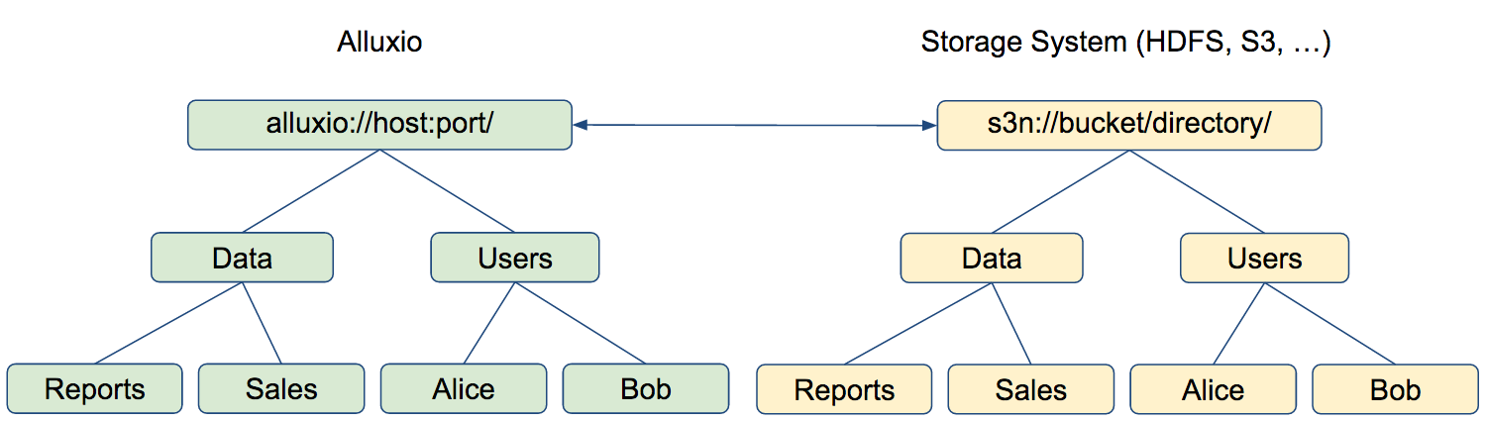
Transparent Naming

Slide 21

Transparent naming maintains an identity between the Alluxio namespace and the underlying storage system namespace.
When a user creates objects in the Alluxio namespace, they can choose whether these objects should be persisted in the underlying storage system. For objects that are persisted, Alluxio preserve the object paths, relative to the underlying storage system directory in which Alluxio objects are stored.
For instance, if a user creates a top-level directory Users with subdirectories Alice and Bob, the directory structure and naming is preserved in the underlying storage system (e.g. HDFS or S3). Similarly, when a user renames or deletes a persisted object in the Alluxio namespace, it is renamed or deleted in the underlying storage system.
Furthermore, Alluxio transparently discovers content present in the underlying storage system which was not created through Alluxio. For instance, if the underlying storage system contains a directory Data with files Reports and Sales, all of which were not created through Alluxio, their metadata will be loaded into Alluxio the first time they are accessed (e.g. when a user requests to open a file). The data of file is not loaded to Alluxio during this process. To load the data into Alluxio, one can read the data using FileInStream or use the load command of the Alluxio shell.

Slide 22
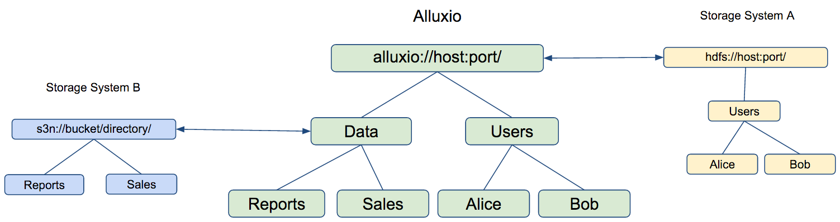
UNIFIED NAMESPACE

Slide 23
A namespace uniquely identifies a set of names so that there is no ambiguity when objects having different origins but the same names are mixed together.
Storing, accessing, and managing data at scale is an increasingly common challenge, rooted in the fact that data typically spans multiple storage systems with different interfaces and independent namespaces.
To address this challenge, Alluxio provides a unified namespace, a feature that greatly simplifies data management at scale by making it possible to interact with different storage systems using the same namespace and interface.
Similar to how a local workstation allows applications to use the same interface to access different devices (such hard disks or USB drives), Alluxio allows distributed applications to use the same interface to access different types of distributed storage systems (such as S3 or HDFS).

Slide 24
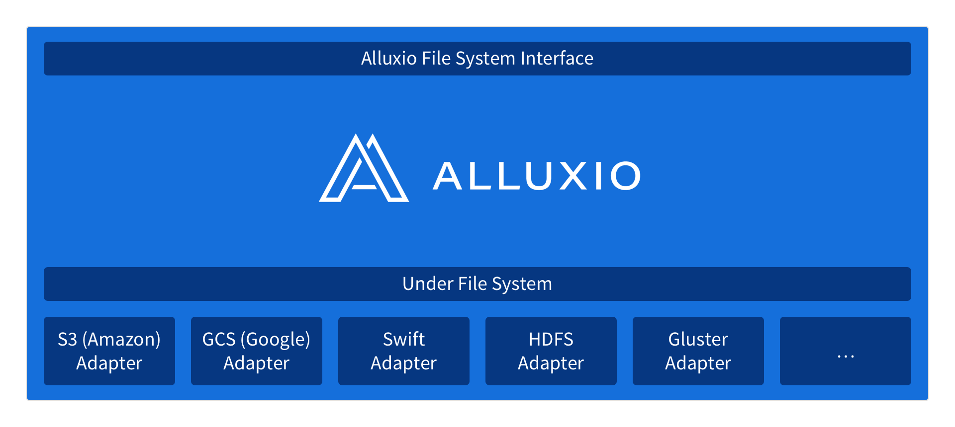
With Alluxio’s unified namespace, applications simply communicate with Alluxio and Alluxio manages the communication with the different underlying storage systems on applications’ behalf.

Slide 25


TIERED STORAGE
APPLICATION
RAM
ALLUXIO
SSD
DISK
PHYSICAL STORAGE

Slide 26
It is a storage networking method where data is stored on various types of media based on performance, availability and recovery requirements.
SSD-solid state drives which are fast drives. SSD are very expensive.
Disks means hard disk drives which are slow drives. These are cheap.
Tiered storage policies place the most frequently accessed data on the highest performing storage.
Rarely accessed data goes on low-performance, cheaper storage.
The data stored into the tiered storage is manage by Alluxio and is not directly accessible- data is chunked into many files with some additional metadata).
each in a series of rows or levels of a structure placed one above the other. a level or grade within the hierarchy of an organization or system.

Slide 27
Alluxio supports tiered storage, which allows Alluxio to manage other storage types in addition to memory. Currently, Alluxio Tiered Storage supports these storage types or tiers:
MEM (Memory)
SSD (Solid State Drives)
HDD (Hard Disk Drives)
Using Alluxio with tiered storage allows Alluxio to store more data in the system at once, since memory capacity may be limited.
With tiered storage, Alluxio automatically manages blocks between all the configured tiers, so users and administrators do not have to manually manage the locations of the data.
Users may specify their own data management strategies by implementing allocators and evictors.
With the introduction of tiers, the data blocks managed by Alluxio are not necessarily in memory; blocks can be in any of the available tiers.
To manage the placement and movement of the blocks, Alluxio uses allocators and evictors to place and re-arrange blocks between the tiers. Alluxio assumes that tiers are ordered from top to bottom based on I/O performance. Therefore, the typical tiered storage configuration defines the top tier to be MEM, followed by SSD, and finally HDD.

Slide 28
ALLOCATORS
Alluxio uses allocators for choosing locations for writing new blocks. Alluxio has a framework for customized allocators, but there are a few default implementations of allocators. Here are the existing allocators in Alluxio:
In the future, additional allocators will be available. Since Alluxio supports custom allocators, you can also develop your own allocator appropriate for your workload.
Greedy Allocator
Allocates the new block to the first storage directory that has sufficient space.
MaxFree Allocator
Allocates the block in the storage directory with most free space.
Round Robin Allocator
Allocates the block in the highest tier with space, the storage directory is chosen through round robin.

Slide 29
Evictors
Alluxio uses evictors for deciding which blocks to move to a lower tier, when space needs to be freed. Alluxio supports custom evictors, and implementations include:
Partial LRU Evictor
Evicts based on least-recently-used but will choose Storage Dir with maximum free space and only evict from that Storage Dir.
LRU Evictor
Evicts the least-recently-used blocks until the required size is freed.
LRFU Evictor
Evicts blocks based on least-recently-used and least-frequently-used with a configurable weight. If the weight is completely biased toward least-recently-used, the behavior will be the same as the LRU Evictor.
Greedy Evictor
Evicts arbitrary blocks until the required size is freed.

Slide 30

Space Reserver
Space reserver makes tiered storage try to reserve certain portion of space on each storage layer before all space on that layer is consumed. This will improve the performance of bursty writes, and may also provide marginal performance gain for continuous writes that may otherwise be slower because eviction is continually running to free up space for the write.
Space reservation can be enforced by configuring high watermark and low watermark per tier. Once the high watermark is reached, a background eviction process is started to free up space till the low watermark is reached.
Storage Directories
A tier is made up of at least one storage directory. This directory is a file path where the Alluxio blocks should be stored. Alluxio supports configuring multiple directories for a single tier, allowing multiple storage devices for a particular tier. For example, if you have five SSD devices on your Alluxio worker, you can configure Alluxio to use all five devices for the SSD tier. Choosing which directory the data should placed is determined by the allocators.

Slide 31
Writing Data
When a user writes a new block, it is written to the top tier by default.
If there is not enough space for the block in the top tier, then the evictor is triggered in order to free space for the new block. If no space is available or can be freed up in the top tier, the write will fail.
Reading data with the ReadType.CACHE or ReadType.CACHE_PROMOTE will also result in the data being written into Alluxio.
Finally, data is written into Alluxio via the load command. In this case also, the data is always written to the top tier.
Reading Data
If the data is already in Alluxio will simply read the block from where it is already stored.
If Alluxio is configured with multiple tiers, then the block will not be necessarily read from the top tier, since it could have been moved to a lower tier transparently.
Reading data with the ReadType.CACHE_PROMOTE will ensure the data is first transferred to the top tier before it is read from the worker.
Pinning Files
A user can control the placement and movement of their files is using pin and unpin files. When a file is pinned, its blocks will not be evicted. However, users can still promote blocks of pinned files to move blocks to the top tier.

Slide 32
Tiering vs. Caching
They are different processes. Tiered data resides on one media type at any time, but moves between media as data access patterns change.(means the data access becomes less or basically it changes.)
Caching temporarily places a copy of the data on a high-performance medium such as dynamic RAM or solid-state memory to improve performance. But the cached data also resides on a lower storage tier, usually an HDD...

Slide 33

MEMORIC CENTRIC
SOPHISTICATED CACHE

Slide 34
The problem Alluxio aims to solve is that while most businesses now create massive amounts of data, they often store them in a number of storage systems and even clouds. To get value from this data, they have to bring all of this information together to analyze it, but that’s hard to do at any speed if your data is stored in all of these different systems.
Alluxio allows compute frameworks like Spark, MapReduce and others to access all of this data by providing a unified namespace across all of these distributed storage systems. It then uses a tiered storage architecture that caches the most often used data in memory, with less often used data on SSDs and traditional hard drives. It’s probably fair to think of Alluxio as a very sophisticated cache for big data workloads.
The software was originally developed at UC Berkeley’s AMPlab and is compatible with the Hadoop file system, which has become somewhat of a standard for storing massive amounts of data across many (often thousands of) machines.

Slide 35

Security and fault tolerance

Slide 36

The Portable Operating System Interface (POSIX)^{[1]} is a family of standards specified by the IEEE Computer Society for maintaining compatibility between operating systems. POSIX defines the application programming interface (API), along with command line shells and utility interfaces, for software compatibility with variants of Unix and other operating systems.^{[2][3]}
Secure Alluxio has two features currently. This document describes the concepts and usage of them.
Authentication: If enabled, Alluxio file system can recognize and verify the user accessing it. It is the basis for other security features such as authorization.
Authorization: If enabled, Alluxio file system can control the user’s access. POSIX permission model is used in Alluxio to assign permissions and control access rights.
By default Alluxio runs in SIMPLE secure mode in which a simple authentication is required. SIMPLE indicates that server trusts whoever the client claims to be.

Slide 37
Authentication
Alluxio provides file system service through Thrift RPC. The client side (representing a user) and the server side (such as master) should build an authenticated connection for communication. If authentication succeeds, the connection will be built. If fails, the connection can not be built and an exception will be thrown to client.
Three authentication modes are supported. JAAS (Java Authentication and Authorization Service) is used to determine who is currently executing the process..
NOSASL
Authentication is disabled. SASL (Simple Authentication and Security Layer) is a framework to define the authentication between client and server applications, which is used in Alluxio to implement authentication feature. So NOSASL is used to represent disabled case and Alluxio file system behavior is as before.
SIMPLE
Authentication is enabled. Alluxio file system can know the user accessing it, and simply believe the user is the one he/she claims.
After a user creates directories/files, the user name is added into metadata. This user info could be read and shown in CLI and UI.
CUSTOM
Authentication is enabled. Alluxio file system can know the user accessing it, and use customized Authentication Provider to verify the user is the one he/she claims.
Experimental. This mode is only used in tests currently.
The Apache Thrift software framework, for scalable cross-language services development, combines a software stack with a code generation engine to build services that work efficiently and seamlessly between languages

Slide 38
AUTHORIZATION
Alluxio file system implements a permissions model for directories and files, which is similar as the POSIX permission model.
Each file and directory is associated with:
an owner, which is the user of the client process to create the file or directory.
a group
permissions
The permissions has three parts:
owner permission defines the access privileges of the file owner
group permission defines the access privileges of the owning group
other permission defines the access privileges of all users that are not in any of above two classes
Each permission has three actions:
read (r)
write (w)
execute (x)
For files, the r permission is required to read the file, and the w permission is required to write the file. For directories, the r permission is required to list the contents of the directory, the w permission is required to create, rename or delete files or directories under it, and the x permission is required to access a child of the directory.

Slide 39
Fault Tolerance in Alluxio is based upon a multi-master approach where multiple master processes are running. One of these processes is elected the leader and is used by all workers and clients as the primary point of contact. The other masters act as standbys using the shared journal to ensure that they maintain the same file system metadata as a new leader and can rapidly take over in the event of the leader failing.(Ref: slide13)
If the leader fails, a new leader is automatically selected from the available standby masters and Alluxio proceeds as usual.
Alluxio uses ZooKeeper to achieve master fault tolerance. Alluxio masters use ZooKeeper for leader election.
Alluxio clients also use ZooKeeper to inquire about the identity and address of the current leader.
ZooKeeper is a centralized service for maintaining configuration information, naming, providing distributed synchronization, and providing group services. All of these kinds of services are used in some form or another by distributed applications. ZooKeeper can be used by applications to ensure that tasks across the cluster are serialized or synchronized. It does this by maintaining status type information in memory on ZooKeeper servers.
Action of causing a set of data to remain identical in more then one location

Slide 40
Configuring Fault Tolerant Alluxio
In order to configure high availability for Alluxio, additional configuration settings must be set for Alluxio masters, workers, and clients.
In conf/alluxio-site.properties, these java options must be set:
To set these options, you can configure your conf/alluxio-site.properties to include:
alluxio.zookeeper.enabled=true
alluxio.zookeeper.address=[zookeeper_hostname]:2181
Property Name | Value | Meaning
alluxio.zookeeper.enabled | true | If true, masters will use ZooKeeper to enable fault tolerance.
alluxio.zookeeper.address | [zookeeper_hostname]:2181 | The hostname and port ZooKeeper is running on. Separate multiple addresses with commas.

Slide 41

What’s new in
Alluxio 1.1 Release

Slide 42

Alluxio 1.1 release includes many great features and improvements.
Performance Improvements
Alluxio Master Metadata Scalability
Efficient and scalable management of the master metadata improves the overall performance of the entire Alluxio system, and enables greater number of concurrent users and applications interacting with Alluxio. In Alluxio 1.1, the file system metadata uses an efficient locking strategy with fine-grained, read-write locking. This enables more users to access the metadata concurrently, resulting in greater scalability. Alluxio 1.1 also improves how the master writes the journal, by preventing performing journal I/O while holding locks. Finally, Alluxio 1.1 enables multiple journal entries to be batched and flushed at the same time, which can greatly improve the throughput of the metadata operations.The master metadata changes in Alluxio 1.1 improves the scalability of metadata operations.
the amount of material or items passing through a system or process
Daily record of events

Slide 43
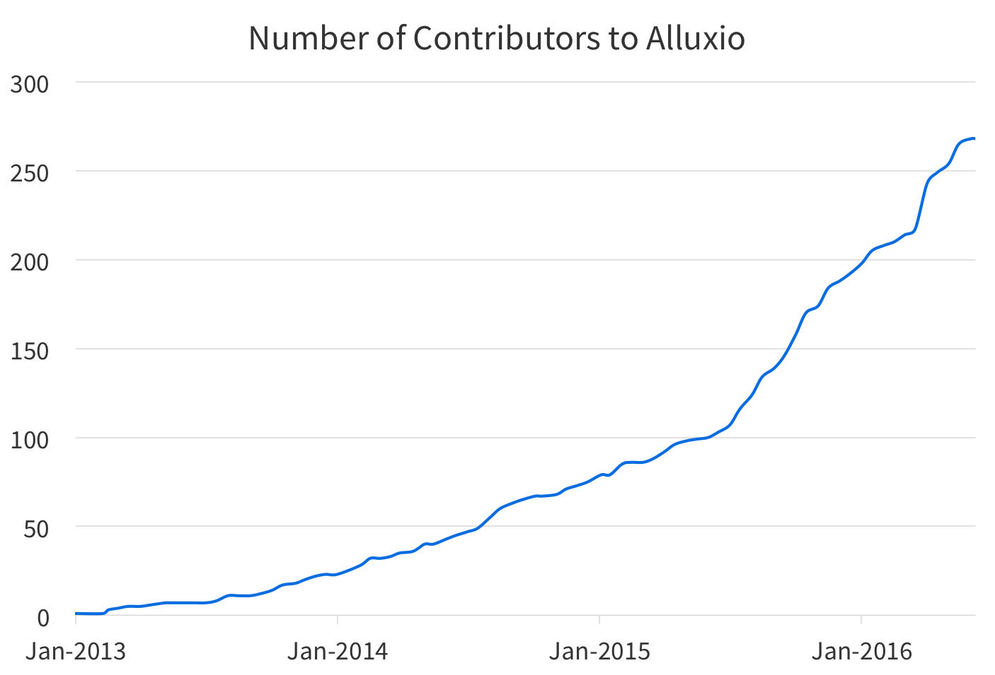

Slide 44
Alluxio Worker Scalability
In addition to the Alluxio Master developments, changes were made to the Alluxio Worker in order to improve scalability. The Alluxio Worker stores and manages all the data, so it is involved in all reads and writes of data. Therefore, increasing the performance of the Alluxio Worker will improve the performance of all applications reading and writing files.
In earlier versions of Alluxio, the performance of the worker would degrade as the worker managed more and more data. While investigating this behavior, the main culprit was how the worker managed the block metadata during operations. As the number of blocks grew on the worker, managing the worker block metadata became more expensive. Therefore, changes were made in the worker to prevent accessing the block metadata when unnecessary.
To evaluate the improvements, experiment was done with the Alluxio worker by continually writing data into the worker. As files and blocks were being written to the worker, the response times of the writes were measured. Below is a chart showing the response time of writes, as the number of blocks grew on the worker.

Slide 45
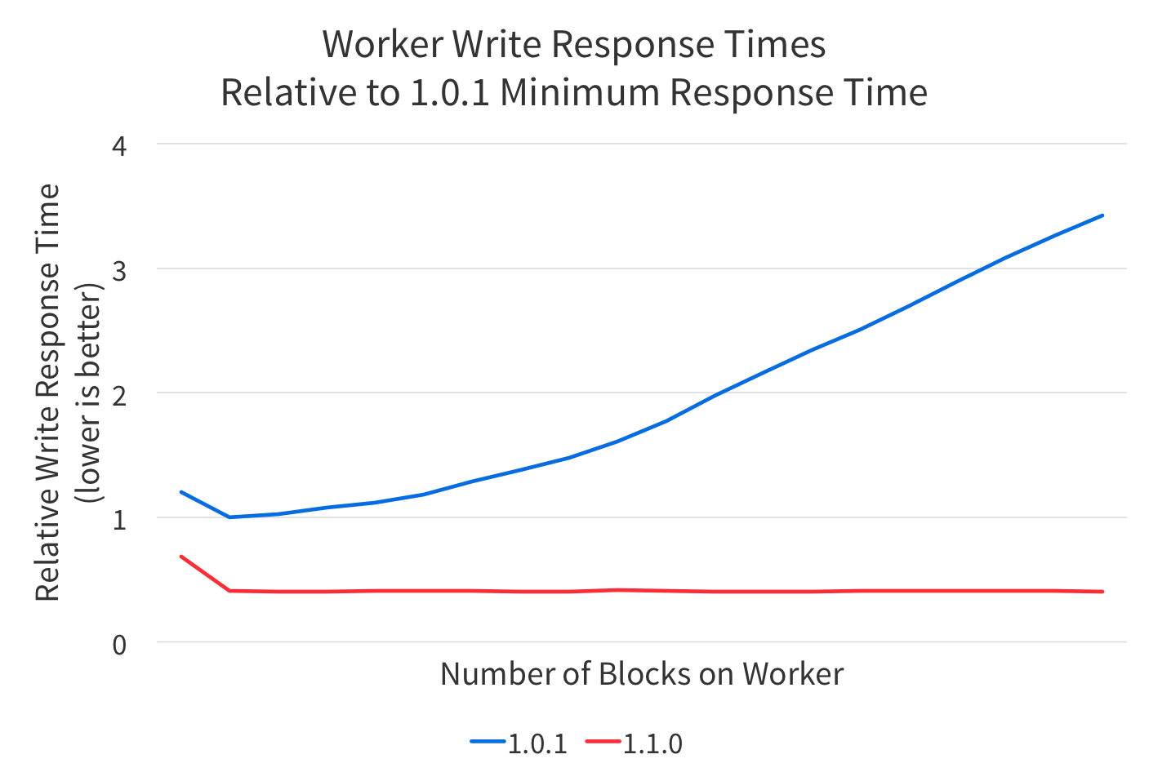

Slide 46
Better Support for Random I/O
Alluxio brings significant performance benefits when the data can be stored in memory, and applications can get direct access to that in-memory data.
However, in earlier versions of Alluxio, a block would only be stored in Alluxio memory if the block was fully read by the application. This means if applications only read a block partially, or seeked around in the block (random I/O ), the block would not be stored in Alluxio.
Alluxio 1.1 introduces a feature that enables storing the entire block in memory even if the block was only partially read. With Alluxio 1.1, files accessed with random I/O can be automatically stored in Alluxio, which could greatly improve performance for applications that uses random I/O.

Slide 47
Usability and Integration Improvements
Automatic Metadata Loading
In earlier versions of Alluxio, metadata from under file systems mounted to Alluxio had to be manually loaded into Alluxio. There was an explicit command to tell Alluxio to gather the metadata from the under file system, and store it in Alluxio. However, this could be cumbersome and confusing, since without invoking the loadMetadata command, files could not be found.
In Alluxio 1.1, the metadata loading is now seamless and done automatically. The metadata from the under file system will be loaded automatically on the first access of the file or directory. With this automatic metadata loading, it is no longer necessary to manually invoke a command to load metadata. This feature helps simplify how users use Alluxio.

Slide 48
Simplified Configuration
Beginning from Alluxio 1.1, configuring the Alluxio system becomes simpler and easier to reason about. In earlier versions, there were many different places to derive configuration settings, it was not always intuitive to set the right configuration in conf/alluxio-env.sh.
Now, Alluxio 1.1 eases this process by providing a more straightforward way to control Alluxio server or application configurations. Environment variables can be used to set Alluxio server settings on each node, such as the IP address, port, ramdisk and etc, through the conf/alluxio-env.sh script on each node. This file conf/alluxion-env.sh is now very simple and no longer contains any logic and only contains a minimal set of environment variables
Google Cloud Platform
Alluxio 1.1 has integration with Google Cloud Platform. With Alluxio 1.1, an Alluxio cluster can be deployed on Google Compute Engine (GCE).
This enables additional options for deploying Alluxio on different public clouds. In addition to being able to deploy Alluxio on GCE, Alluxio 1.1 also supports mounting data stored in Google Cloud Storage (GCS).
specifying a set of directories where executable programs are located
the practice of using a network of remote servers hosted on the Internet to store, manage, and process data,

Slide 49

BENEFITS OF ALLUXIO

Slide 50
The choice to use the memory as primary storage makes lot of sense as the RAM throughput increases exponentially (and cost decreases exponentially as well, -50% every 18 months).
The disk throughput increases more slowly.
More and more application uses memory. MapReduce has moved from disk io (with Hadoop) to memory io (with Spark).
Memory compute engines (e.g. Spark) have increased the performance significantly but the problem isn’t solved yet because it lacks a storage layer

Slide 51
DECOUPLING
The most obvious benefit is that is decouples the applications from the physical storage. (forms a layer between storage system and applications like spark, pig, kafka, etc.) The application just needs to integrate with Alluxio and they can automatically support any of the physical storages supported by Alluxio.
The integration is pretty simple as Alluxio provides different interfaces to integrate with including HDFS, key/value and file system interfaces. It means that as soon as your framework can “talk”(means it can fetch and work with data stored in file system) to one of these interfaces it can integrate with Alluxio.
E.g if your framework works only on top of HDFS it can integrate with Alluxio and support S3, GlusterFS, GCS (Google Cloud Storage), ….for free.

Slide 52
THE SPEED
As Alluxio sits between the application and the physical storage it can save the data into its own memory as it fetches it from the real storages.
As a result you gain speed: it ‘s much faster to read data from Alluxio’s memory than from S3 going over the internet.
Alluxio provides some additional tiered storage for SSD and disks in addition to memory.

Slide 53
THE LINEAGE
This feature is disabled by default but seemed quite interesting to me. The idea – taken from Spark – is to keep track of which jobs produce which data.
So that if some data is no longer accessible Alluxio can re-trigger the jobs that generated the data.
This allows huge saving in terms of space. You don’t need to duplicate all the data several times over the cluster. You can only store it once and recompute it in the seldom case of failure.

Slide 54
Alluxio Master Web Interface
The Alluxio master serves a web interface to help manage the system. The default port for the Alluxio master web interface is 19999, so the web interface can be viewed by visiting http://<MASTER IP>:19999.
The Alluxio master web interface contains several different pages, described below.
The home page gives an overview of the system status. It includes the following sections:
Alluxio Summary Alluxio system level information
Cluster Usage Summary Alluxio storage information as well as under storage information. Alluxio storage utilization can be near 100%, but under storage utilization should not approach 100%.
Storage Usage Summary Alluxio tiered storage information which gives a break down of amount of space used per tier across the Alluxio cluster.

Slide 55

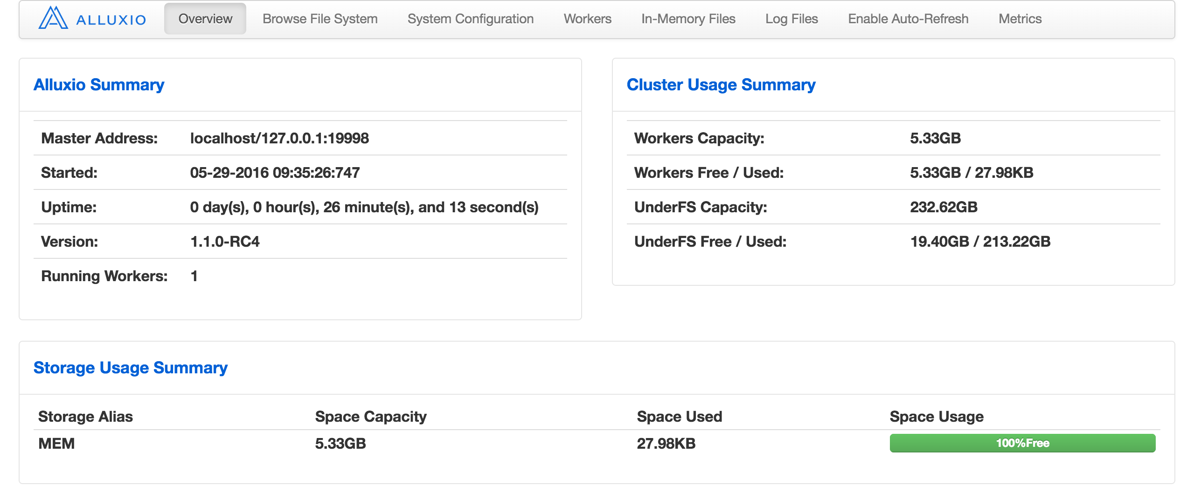

Slide 56
UNIFIED NAMESPACE
Future-proofing your applications: applications can communicate with different storage systems, both existing and new, using the same namespace and interface; seamless integration between applications and new storage systems enables faster innovation
Enabling new workloads: integrating an application or a storage system with Alluxio is a one-time effort which enables the application to access many different types of storage systems and the storage system to be accessed by many different types of applications

Slide 57
ACCELERATE ACCESS TO REMOTE STORAGE
Running big data computational frameworks slows to a crawl when queries require access to and from data stored remotely.
Accelerate local and remote data access with Alluxio and eliminate I/O bottlenecks.
Share Data Across Jobs at Memory Speed
Performance can slow when data output of one job is input for the next job or when different applications and jobs require access to the same data.
Alluxio shares data transparently at memory speed to any application.

Slide 58

Alluxio today

Slide 59

Beyond the numbers, we have seen that Alluxio is solving critical problems in enterprises across different industries around the world.
For example, search giant Baidu has been running Alluxio in their production for more than a year. Alluxio brings them 30X performance improvement. The company says that it has helped Baidu to improve the performance of some of that companies’ ad-hoc interactive queries on multiple petabytes of data that was originally stored in different data centers from 15 minutes to 30 seconds.
Barclays, a world leading bank, uses Alluxio to make the impossible possible, by reducing the end-to-end latency from hours to seconds.
Public cloud providers such as Alibaba and RackSpace have also shown how Alluxio virtualizes their object storage systems.

Slide 60
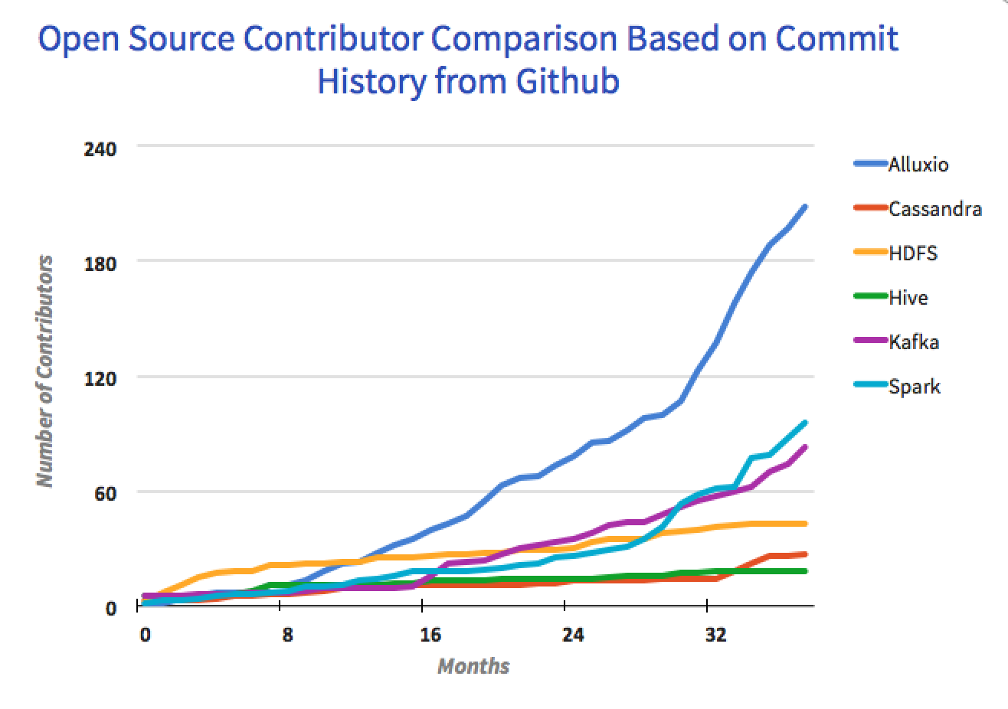

Slide 61
Intel has published articles to showcase several ways to leverage Alluxio in their customers’ environments.
IBM presented how Alluxio can abstract OpenStack storage to enable fast data analytics.
It has been exciting to see the project adoption grow from zero companies to many, including various industry leaders.
The achievements thus far validate the tremendous potential of Alluxio and demonstrate the industry and community’s great excitement around it.

Slide 62
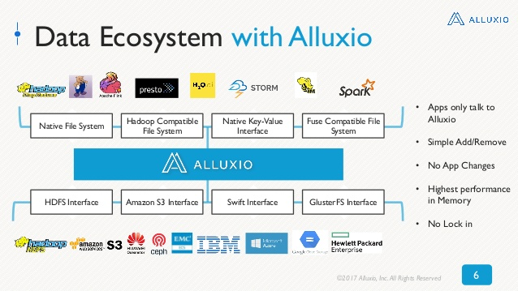

Slide 63

MINI PROJECT

Slide 64
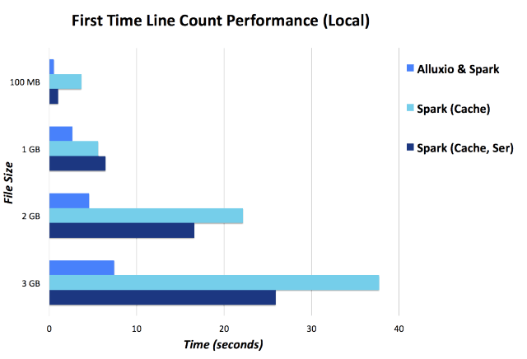

Slide 65
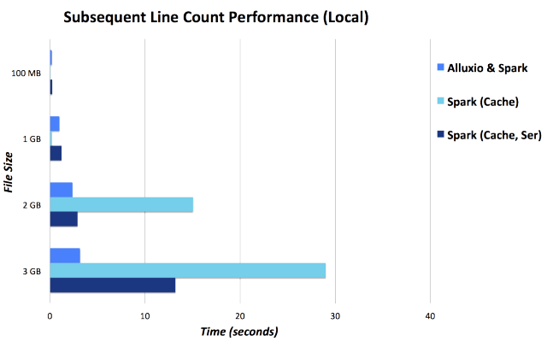

Slide 66
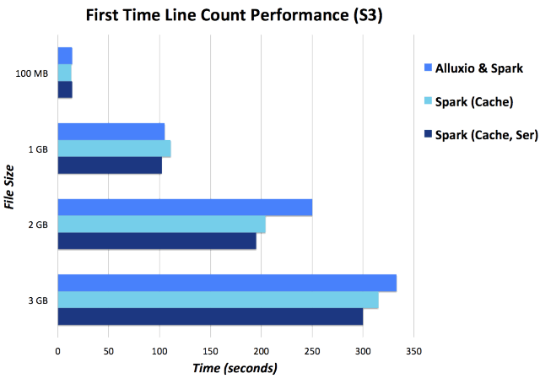

Slide 67
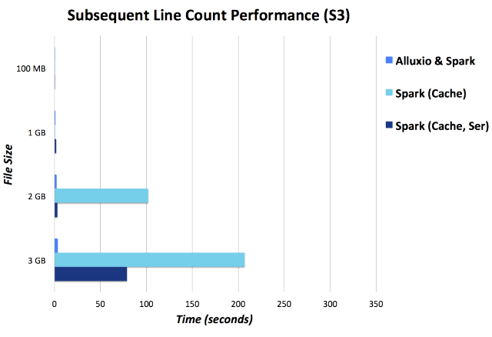

Slide 68

Sachin Yadav
Amulya Agrawal
Harsh Gupta
THANK YOU

